Slide 1
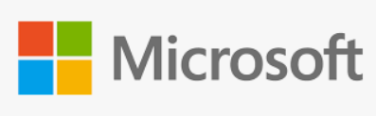
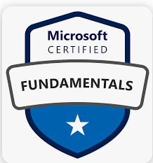
Azure Fundamentals (AZ-900)

Slide 2
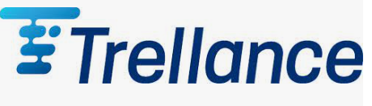
Day – 4 Azure Compute And Networking Services

Slide 3
Outlines
Azure container instance (ACI)
Azure App services
Azure Functions
Azure Network services

Slide 4
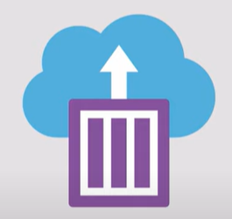
Azure Container Instance (ACI)
Containers are a virtualization environment. Much like running multiple virtual machines on a single physical host, you can run multiple containers on a single physical or virtual host.
Supports both Linux containers and Windows containers.
Azure Container Instances are PaaS.
Allow you to upload your containers and then the service will run the containers fastest for you.
It eliminates the need for a developer to provision virtual machines (VMs) or implement a container orchestration platform, such as Kubernetes, Docker to deploy and run containers.
Notes:
A container is a unit of software that packages code and its dependencies, so the application runs quickly and reliably across computing environments.

Slide 5
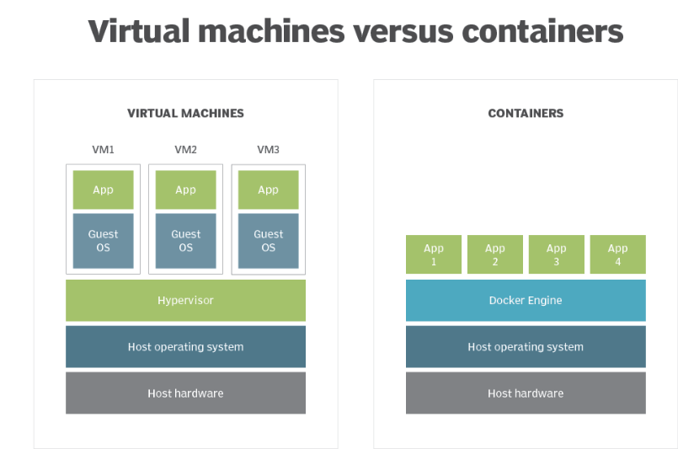
VMs vs Container
Notes:
a program used to run and manage one or more virtual machines on a computer.
Docker Engine is an open source containerization technology for building and containerizing your applications.

Slide 6
Azure App Services
App Service is type of PaaS and provide application hosting option on the cloud.
Both VMs and containers provide excellent hosting solutions
App Service is a robust hosting option that you can use to host your apps in Azure
App Service focus on building and maintaining your app, and Azure focuses on keeping the environment up and running.
It offers automatic scaling and high availability.
App Service supports Windows and Linux.
It enables automated deployments from GitHub, Azure DevOps, or any Git repo to support a continuous deployment model.

Slide 7
Types of App services
1. Web apps
2. API apps
3. WebJobs
4. Mobile apps
It supports multiple languages, including .NET, Java, Ruby, Node.js, PHP, Python.
Pros:
Sites can be scaled quickly to handle high traffic loads.
The built-in load balancing and traffic manager provide high availability.

Slide 8
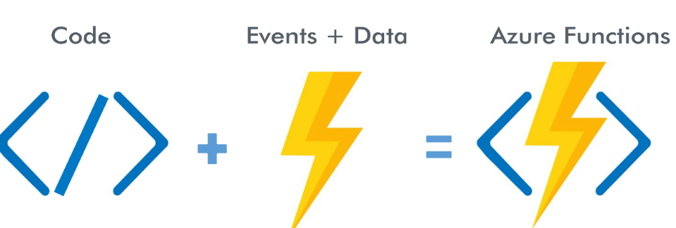
Azure Functions
It is a serverless computing service provided by MS Azure.
Functions allows you to run small pieces of code (called "functions") without worrying about platform or infrastructure.
Build and deploy small, event-driven applications or functions in the cloud that can be triggered by various events or triggers.
These functions are written in C#, JavaScript, Python or PowerShell.
Notes:
https://www.youtube.com/watch?v=eS5GJkI69Qg&ab_channel=WafaStudies
What do we think about whne we develop an application ?
Where to deploy ? what kind of server ? What OS?
How do we take care of scaling and availability of the application?
What if you don't need to worry about servers and focus on your code?
Enter serverless
Remember : serverless does not mean "No servers"
You don't worry about infrastructure
Flexible scaling and automated high availability
Most important : Pay for use
Ideally Zero request ==> Zero cose
You focus on code and the cloud managed service takes care of all that is
needed to scale your code to server millions of request
Pay for requests and not servers

Slide 9
Events/Triggers
Commonly used in Azure functions:
HTTP Trigger
Timer Trigger
Blob Trigger
Queue Trigger
Event Grid Trigger
Cosmos DB Trigger

Slide 10
Function Use case
Azure Functions runs your code when it's triggered and automatically deallocates resources when the function is finished.
only charged for the CPU time used while your function runs.
Building a notification system for an e-commerce website.
Example: you have an online store send notification to the customer whenever a new product is added to a specific category, they are interested in.
Azure functions to achieve the above one using the below way
1) Trigger 2) Function Logic 3) Notification Generation 4) Notification Delivery

Slide 11

Azure Networking Services
Virtual Network
VPN Gateway
Azure Express Route
Azure DNS
Content Delivery Network (CDN)
Notes:
https://www.youtube.com/watch?v=inaXkN2UrFE

Slide 12
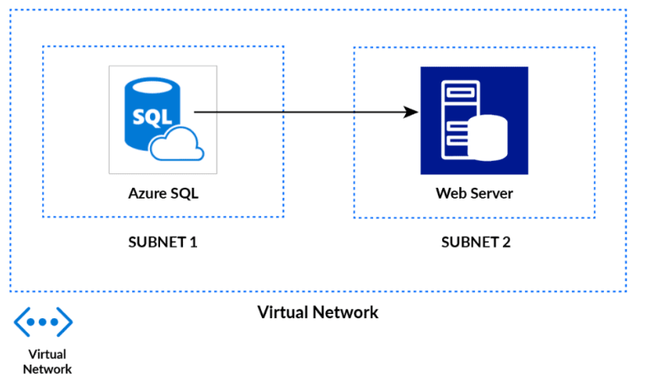
Virtual Network
Represents your network environment to run VMs and applications in the cloud.
When it is created, the services and Virtual Machines within the network interact securely with each other over the internet.
The main purpose of Virtual Networks is to act as a communication channel between resources launched in the cloud.
Notes:
The primary purpose of a VNet is to enable communication and connectivity between various resources deployed in the Azure cloud, such as virtual machines, Azure App Services, and databases. It allows you to create your own virtual network topology, define IP address ranges, and configure network settings such as subnets, security groups, and routing tables.
It helps protect your resources from unauthorized access and provides network segmentation.
Suppose you are a company that is migrating its on-premises infrastructure to the Azure cloud. You have multiple virtual machines (VMs) hosting different services, such as a web server, application server, and database server. To ensure security and isolation, you decide to deploy these VMs within a Virtual Network (VNet).
Here's how VNet can be used in this scenario:
Creating a VNet: You start by creating a VNet in Azure, defining the IP address range for the VNet. For example, you might specify the IP range as 10.0.0.0/16.
Subnet Configuration: Within the VNet, you define multiple subnets to segregate the VMs based on their functionalities. For instance, you can create a "Web Subnet" for the web server VM, an "Application Subnet" for the application server VM, and a "Database Subnet" for the database server VM. Each subnet can have its own IP address range.
Network Security Groups (NSGs): NSGs are associated with subnets and provide inbound and outbound traffic filtering for the VMs. You can configure rules to allow or deny specific protocols, ports, or IP ranges. For example, you can create a rule to allow HTTP traffic (port 80) only to the VMs in the "Web Subnet."
Network Connectivity: You can establish connectivity within the VNet and to the outside world. For example, you might configure a virtual private network (VPN) gateway to connect the VNet to your on-premises network, allowing communication between the VMs in Azure and your local network.
Load Balancer: To distribute incoming traffic across the web server VMs, you can deploy an Azure Load Balancer within the VNet. It provides high availability and scalability by evenly distributing requests among the VMs.
By deploying your VMs within a VNet and configuring the network settings, you achieve network isolation, security, and control. The VNet acts as a virtual network infrastructure, enabling communication between the VMs, managing network traffic, and providing connectivity to your on-premises envir

Slide 13
Benefits of VNet
Provides an isolated environment for your application
Internet communication(A Subnet in a VNet can access the public internet by default)
Traffic can be easily filtered from resources
Route network traffic
Communicate with on premises resources
Connect virtual networks (Network peering)
Notes:
https://k21academy.com/microsoft-azure/architect/virtual-networks-in-microsoft-azure-vnet-peeringexpressroutevpn-gateway/
https://www.youtube.com/watch?v=Wb2rAYQ3Qbc&ab_channel=Simplilearn

Slide 14
Components of Azure Virtual Network
3 Components
1. Subnet : a specific range of IP addresses
2. Routing : the process of directing network traffic from its source to its destination
3. Gateway : network device that serves as an entry or exit point between different networks.
4. Firewall : monitors and controls incoming and outgoing network traffic based on security rules.
5. A network interface is the point of interconnection between a computer and a private or public network
6. Network Security Group (NSG) :
A network security group contains security rules that allow or deny inbound network traffic to, or outbound network traffic from, several types of Azure resources.
Notes:
https://www.testpreptraining.com/blog/what-is-the-difference-between-public-and-private-subnet-in-aws/
A network security group contains security rules that allow or deny inbound network traffic to, or outbound network traffic from, several types of Azure resources. For each rule, you can specify source and destination, port, and protocol
NSG stands for Network Security Group. It is a fundamental network security feature in Microsoft Azure that acts as a virtual firewall for controlling inbound and outbound traffic to Azure resources.
Here's an example of a real-time application of NSGs:
Suppose you are managing a multi-tier web application deployed in Azure that consists of a web server, an application server, and a database server. To secure the communication between these components and control network traffic, you can use NSGs.
By using subnets, you achieve network segmentation, efficient IP address allocation, and improved security within your organization's network infrastructure. Each department has its own subnet, allowing for logical separation, better control over network traffic, and easier management of resources.
Suppose you work for a large organization that has multiple departments, each requiring their own network segment. To achieve network segmentation and efficient IP address allocation, you decide to use subnets.
Here's how subnets can be used in this scenario:
Departmental Network Segmentation: You have departments such as Finance, Marketing, and IT. To separate their network traffic and ensure security and privacy, you create separate subnets for each department. For example, you might create the Finance Subnet, Marketing Subnet, and IT Subnet.
IP Address Allocation: Each subnet is assigned a specific IP address range that is unique within the larger network. For instance, the Finance Subnet may be assigned the IP range 192.168.1.0/24, the Marketing Subnet 192.168.2.0/24, and the IT Subnet 192.168.3.0/24. This allows devices within each subnet to have IP addresses within their respective ranges.
Network Routing: Routers are configured to connect the subnets and enable communication between them. Routing tables are set up to direct network traffic between subnets based on their IP addresses

Slide 15
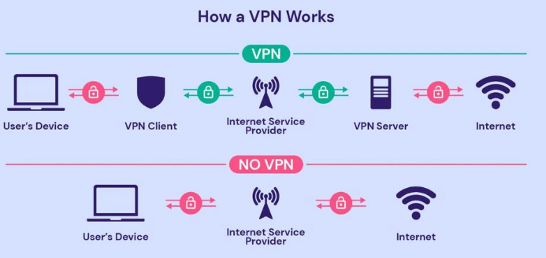
VPN Gateway
A VPN gateway is a specific type of virtual network gateway, which is used to send encrypted traffic between an Azure virtual network and an on-premises location over the public internet.
VPN gateway act as a middleman on both sides of the virtual networks.
And if the workloads in those virtual networks need to communicate with each other, they will communicate via this encrypted channel of communication between the VPN gateways of both virtual networks.
Notes:
A gateway in a network converts information from one protocol to another and then transfers it over the web.
For example, if a computer on the Internet sends an email to another, the gateway converts the message from one protocol to another and sends it back
Suppose you work for a company that has multiple branch offices located in different cities. To provide secure communication and connectivity between these offices, you decide to set up a VPN infrastructure using VPN Gateways.
By deploying VPN Gateways, you can establish secure and private communication channels between different networks. It enables branch offices to securely access resources in the company's headquarters and allows remote users to connect to the corporate network from anywhere, ensuring data confidentiality and integrity.

Slide 16
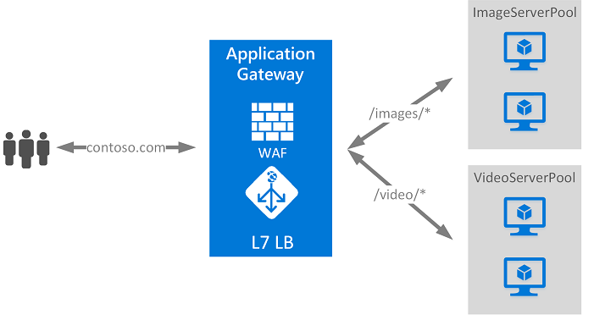
Azure Application Gateway
It is a web traffic load balancer that enables you to manage traffic to your web applications
Application Gateway can make routing decisions based on additional attributes of an HTTP request.
Notes:
https://learn.microsoft.com/en-us/azure/application-gateway/overview
Azure Application Gateway is a web traffic load balancer that enables you to manage traffic to your web applications.
Traditional load balancers operate at the transport layer (OSI layer 4 - TCP and UDP) and route traffic based on source IP address and port, to a destination IP address and port

Slide 17
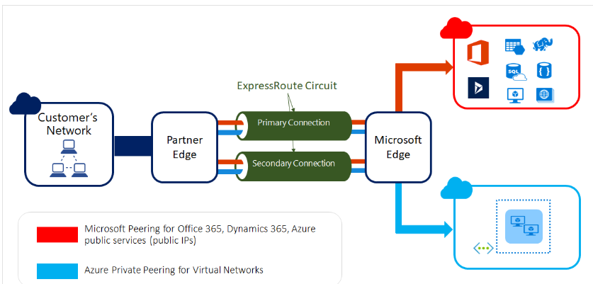
Azure Express Route
Extend your on-premises networks into the Microsoft cloud over a private connection, with the help of a connectivity provider.
Connectivity can be from an any-to-any (IP VPN) network, a point-to-point Ethernet network, or a virtual cross-connection through a connectivity provider at a colocation facility.
ExpressRoute connections don't go over the public Internet.

Slide 18
Azure DNS
Hosting service for DNS domains that provides name resolution by using Azure infrastructure.
Manage DNS records using the same credentials, APIs, tools, and billing as your other Azure services.
Benefits of Azure DNS
Note : You can't use Azure DNS to buy a domain name.
Reliability and performance
Security
Ease of Use
Customizable virtual networks
Alias records
Notes:
DNS stands for Domain Name System. It is a hierarchical decentralized naming system that translates domain names (such as www.example.com) into IP addresses (such as 192.0.2.1). DNS is essential for the functioning of the internet as it enables users to access websites and other internet resources using user-friendly domain names instead of remembering complex IP addresses.

Slide 19
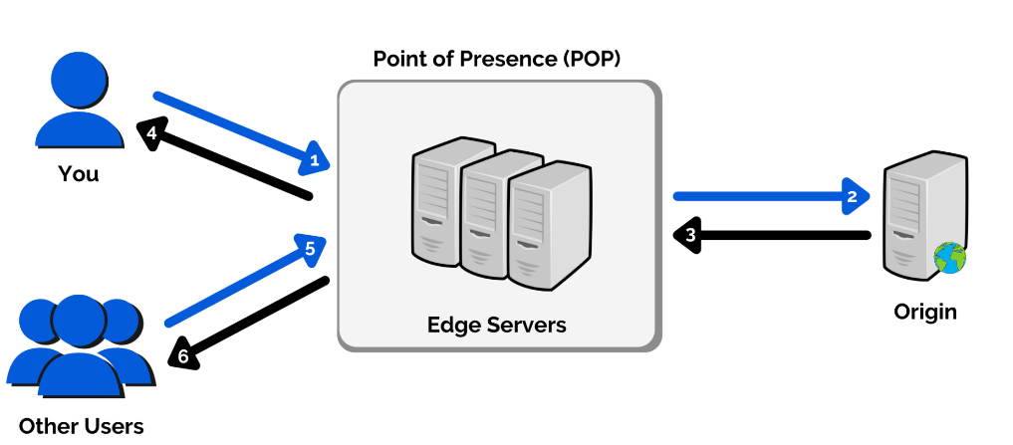
Azure CDN (Content Delivery Network)
CDN is a global solution for organizations to adapt and deliver high bandwidth content.
With the help of Azure CDN, you can prefer to cache static objects that are loaded from a web application or Azure blob storage by using the nearest Point of Presence (POP).
Notes:
https://www.whizlabs.com/blog/azure-cdn-complete-guide/
By using Azure CDN, you can significantly improve the delivery speed and user experience of your website's static content. It reduces latency, optimizes bandwidth usage, and provides a more responsive browsing experience for users around the world.
It's important to note that Azure CDN can also be used to accelerate the delivery of dynamic content, live streaming, and other types of content delivery scenarios
Azure CDN (Content Delivery Network) is a global distributed network of servers that helps deliver high-bandwidth content to users with low latency and high performance. It caches and distributes content across multiple edge locations worldwide, closer to end-users, reducing the distance data needs to travel and improving content delivery speed.
Here's an example of a real-time application of Azure CDN:
Suppose you have a website that serves static content such as images, videos, CSS files, and JavaScript files. To improve the performance and user experience, you decide to leverage Azure CDN.

Slide 20
Quiz Time

Slide 21
Q
A

